Slide 1



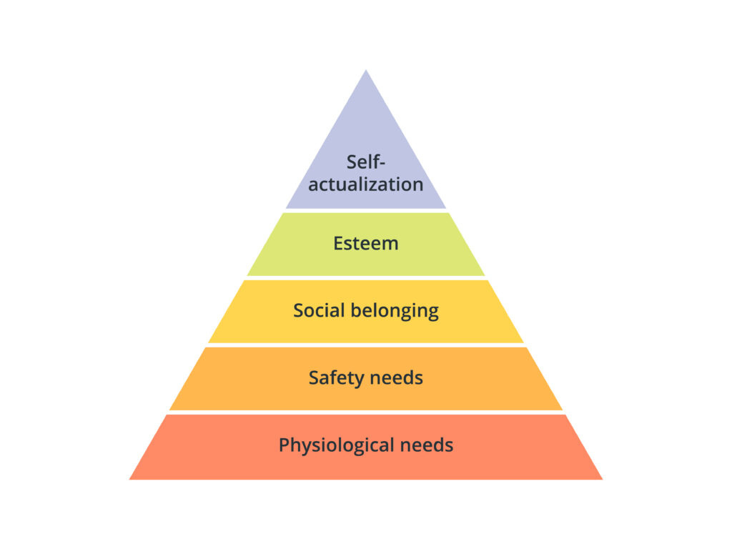
MASLOW'S
HIERARCHY OF NEEDS

Slide 2

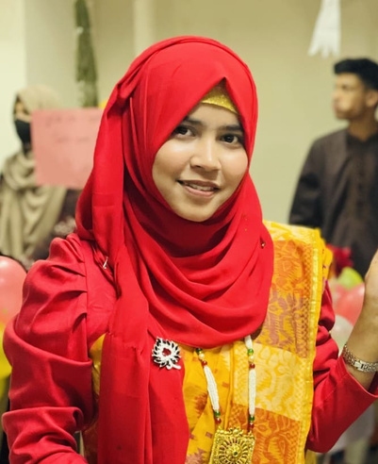







Meet The Team & Topics
Sayma Sultana
Arif Khan
Mariya Sanzi
Humaira Akter
Dipok Sarkar
Maruf Khan
2223081069
2223081071
2223081054
22230810750
2223081078
2223081070
About Maslow
Love & Belongingness Needs
Self-Actualization Needs
Introduction
Physiological Needs,
Esteem Needs
Overview
Five levels needs
Safety Needs
Maslow Limitations

Slide 3







Introduction
Maslow's theory is one of the most important ideas about human motivation. Motivation means the inner force that inspires people to act or achieve goals. In management, this theory helps leaders motivate employees. In psychological, it helps us understand human behaviour and personal growth.
Theory explains human motivation.
Motivation = inner drive.
Helps managers and psychologists.

Slide 4

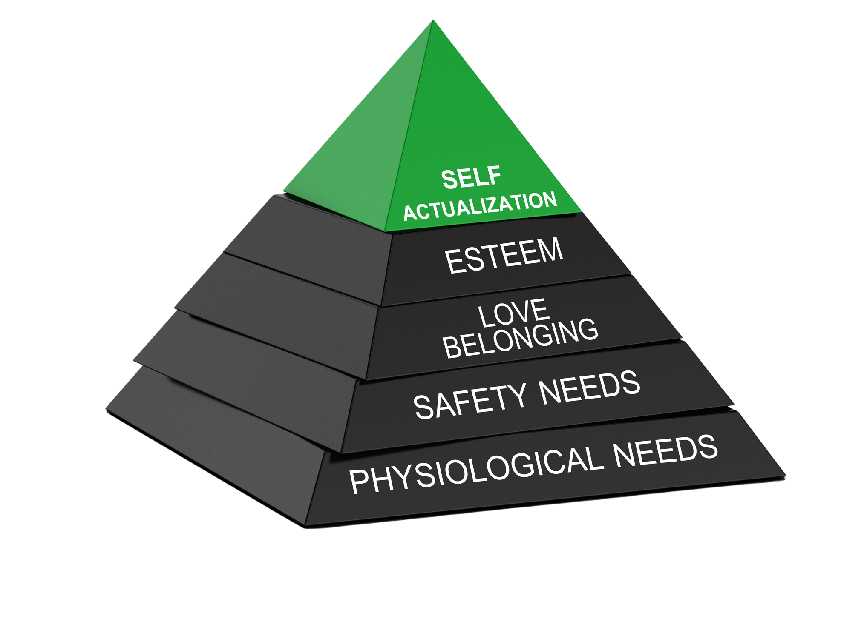



Maslow’s Theory Overview
Maslow said that human needs are arranged in a hierarchy. First come physiological needs,then safety, then love & belonging, then esteem & at the top is self actualization. He showed this using a pyramid to explain how people move from lower needs to higher needs.
Needs arranged in levels.
Physical → Safety → Love → Esteem → Self-actualization.
Move from lower to higher needs.

Slide 5
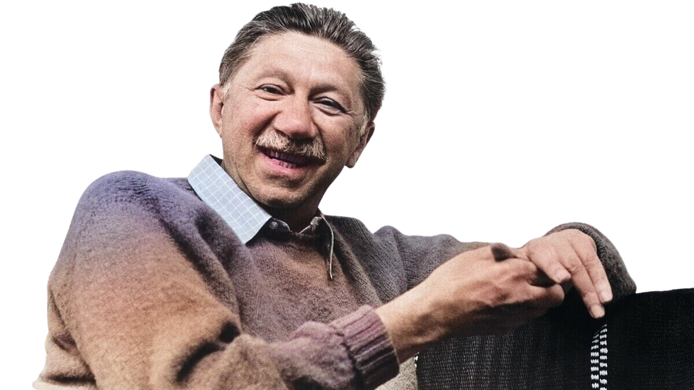
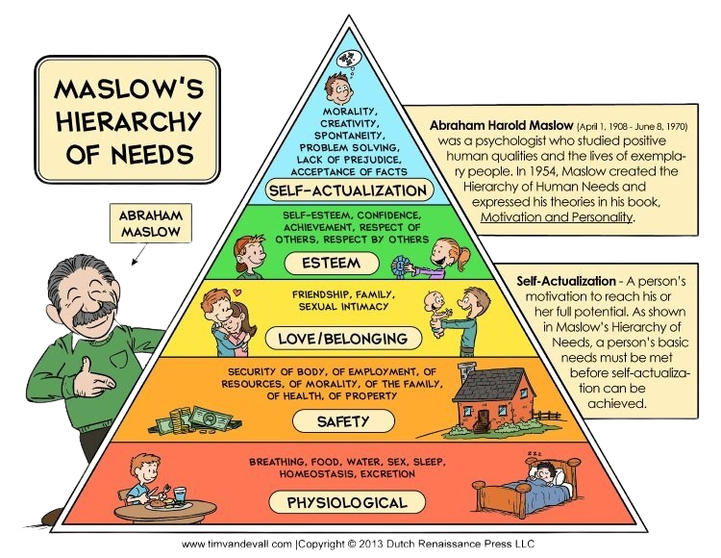

Abraham Maslow
Abraham Harold Maslow was an American psychologist known for studying human motivation. Who developed the hierarchy of needs.
Born: April 1, 1908
He is considered one of the founders of Humanistic Psychology.
He first introduced this theory in 1943 in his research paper.
But he explained this idea in 1954 in his book “Motivation and Personality.”
He arranged this needs into five levels, from basic to advanced.
People must satisfy lower levels needs before focusing higher levels needs.
Maslow represented this model as a pyramid.

Slide 6
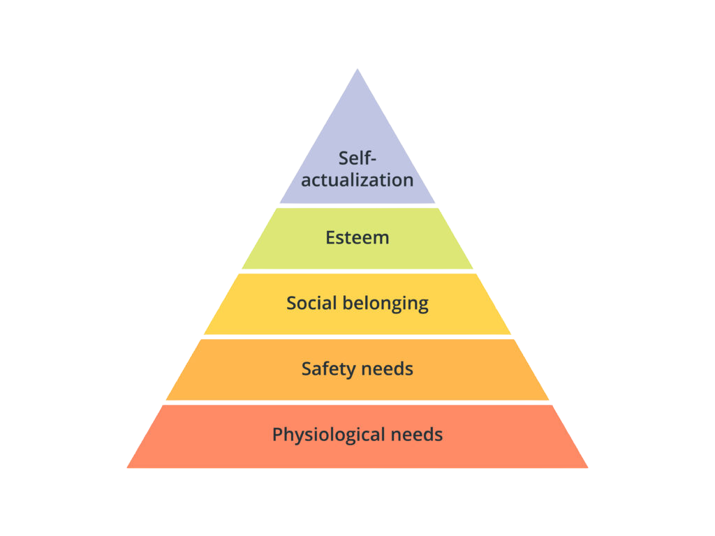

PHYSIOLOGICAL NEEDS
SAFETY NEEDS
THE FIVE LEVELS OF THE Hierarchy
LOVE & BELONGINGNESS NEEDS
ESTEEM NEEDS
SELF-ACTUALIZATION NEEDS

Slide 7


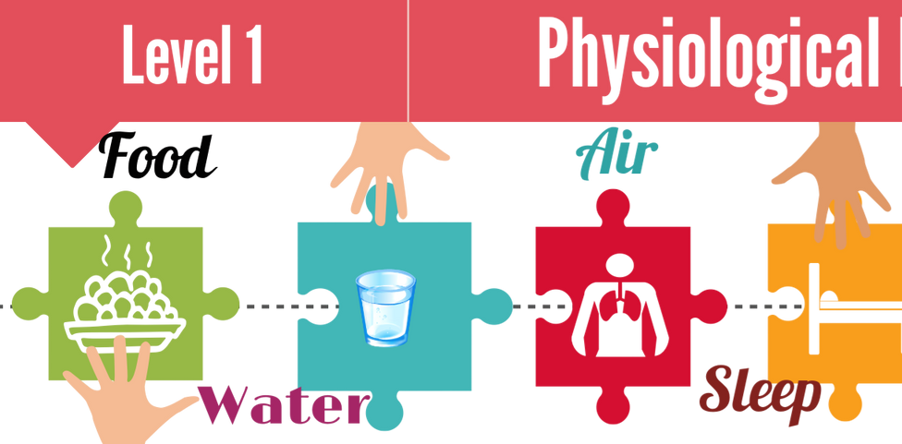
Physiological Needs
Physiological needs are the basic physical requirements that a human body must have to survive. These include essential things such as food, water, air, sleep, clothing, and shelter.
Without fulfilling these basic needs, a person cannot focus on higher-level needs like safety, love, or self-esteem.
Food
Water
Shelter
Sleep

Slide 8
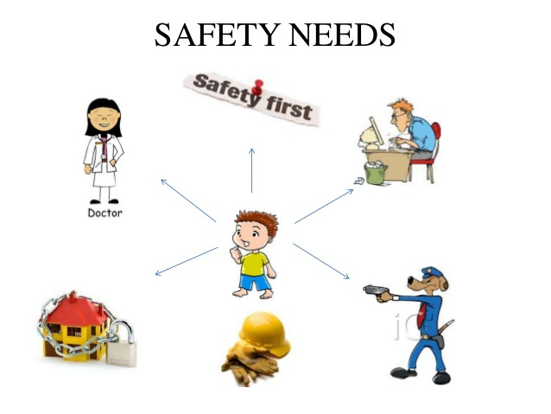


SAFETY NEEDS
Safety needs refer to a person’s need for protection, security, and stability in their life. This includes physical safety, financial security, health protection, and a safe environment.
When people feel unsafe or insecure, they focus on protecting themselves before pursuing higher-level needs like love, esteem, or self-actualization.
Physical safety
Emotional safety
Job security
Financial security

Slide 9
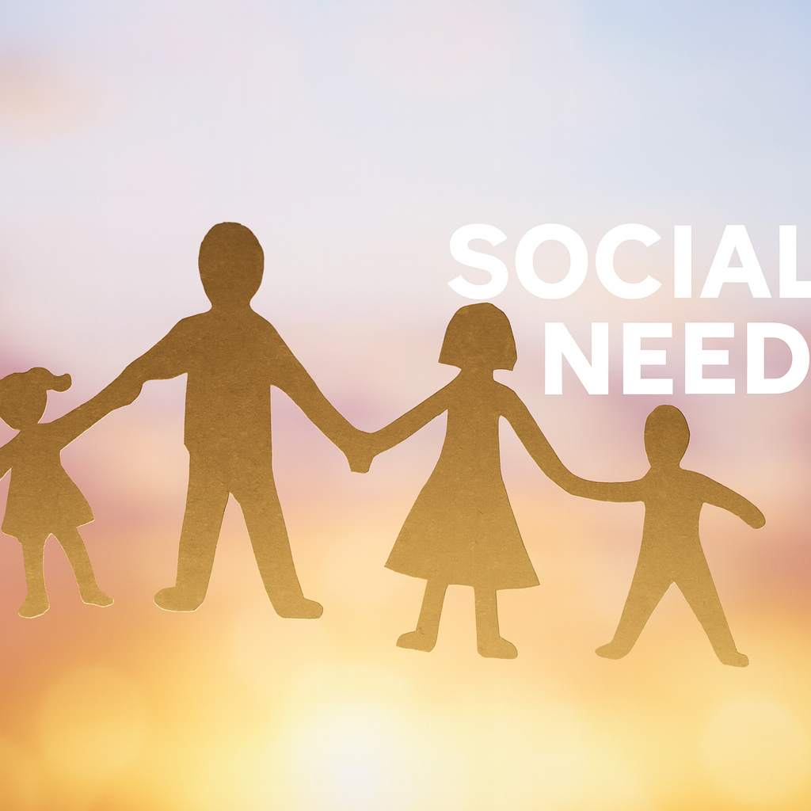
LOVE & BELONGINGNESS Needs
Love and Belongingness Needs represent an individual’s desire for meaningful social relationships, emotional attachment, and a sense of being accepted by others.
These needs become important once physiological and safety needs are fulfilled. At this stage, people naturally seek connections that provide affection, support, and companionship.
Friendship
Family
Community
Teamwork

Slide 10
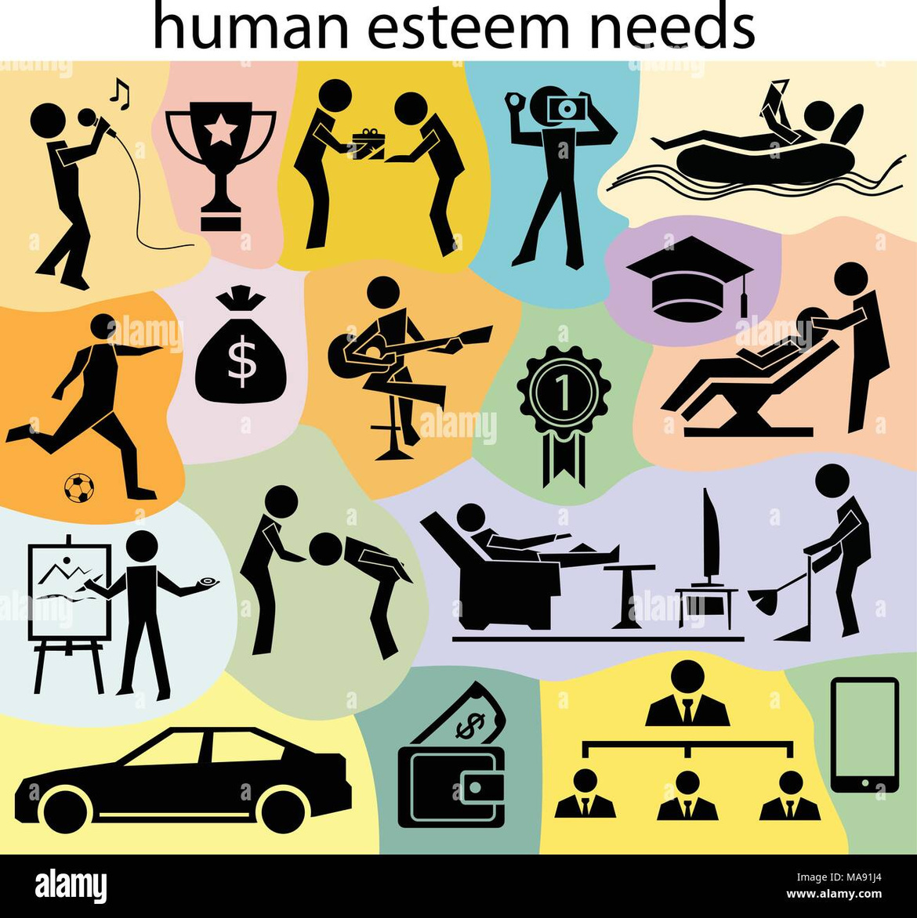


Esteem Needs
Esteem Needs refer to a person’s desire for respect, recognition, self-worth, and a sense of accomplishment. After fulfilling physiological, safety, and social needs, individuals naturally strive to feel valued—both by themselves and by others. When Esteem Needs are satisfied, people feel confident, motivated, and more willing to take on challenges.
However, if these needs are not met, individuals may experience feelings of inferiority, weakness, or lack of value.
Esteem needs might include:
Celebrity
Dignity
Recognition
Fame
Prestige

Slide 11


Self-Actualization Needs
Self-Actualization refers to feeling fulfilled, or feeling that we are living up to our potential. One unique feature of self-actualization is that it looks different for everyone. For one person, self-actualization might involve helping others; for another person, it might involve achievements in an artistic or creative field. Essentially, self-actualization means feeling that we are doing what we believe we are meant to do.
Personal Growth
Creativity & Innovation
Purpose & Meaning
Peak Experiences

Slide 12


Limitations of Maslow’s Hierarchy of Needs
Hierarchy may not apply to everyone
Maslow suggested that all humans follow the same step-by-step order of needs. But in reality, people do not always follow this order.
Needs may overlap
People often pursue multiple needs at the same time. A person may seek love, safety, and self-esteem all together.
No strong scientific proof
Maslow’s theory is popular and logical, but it lacks strong experimental evidence.There are no large-scale scientific studies that confirm people always move from lower needs to higher needs in the same order.

Slide 13
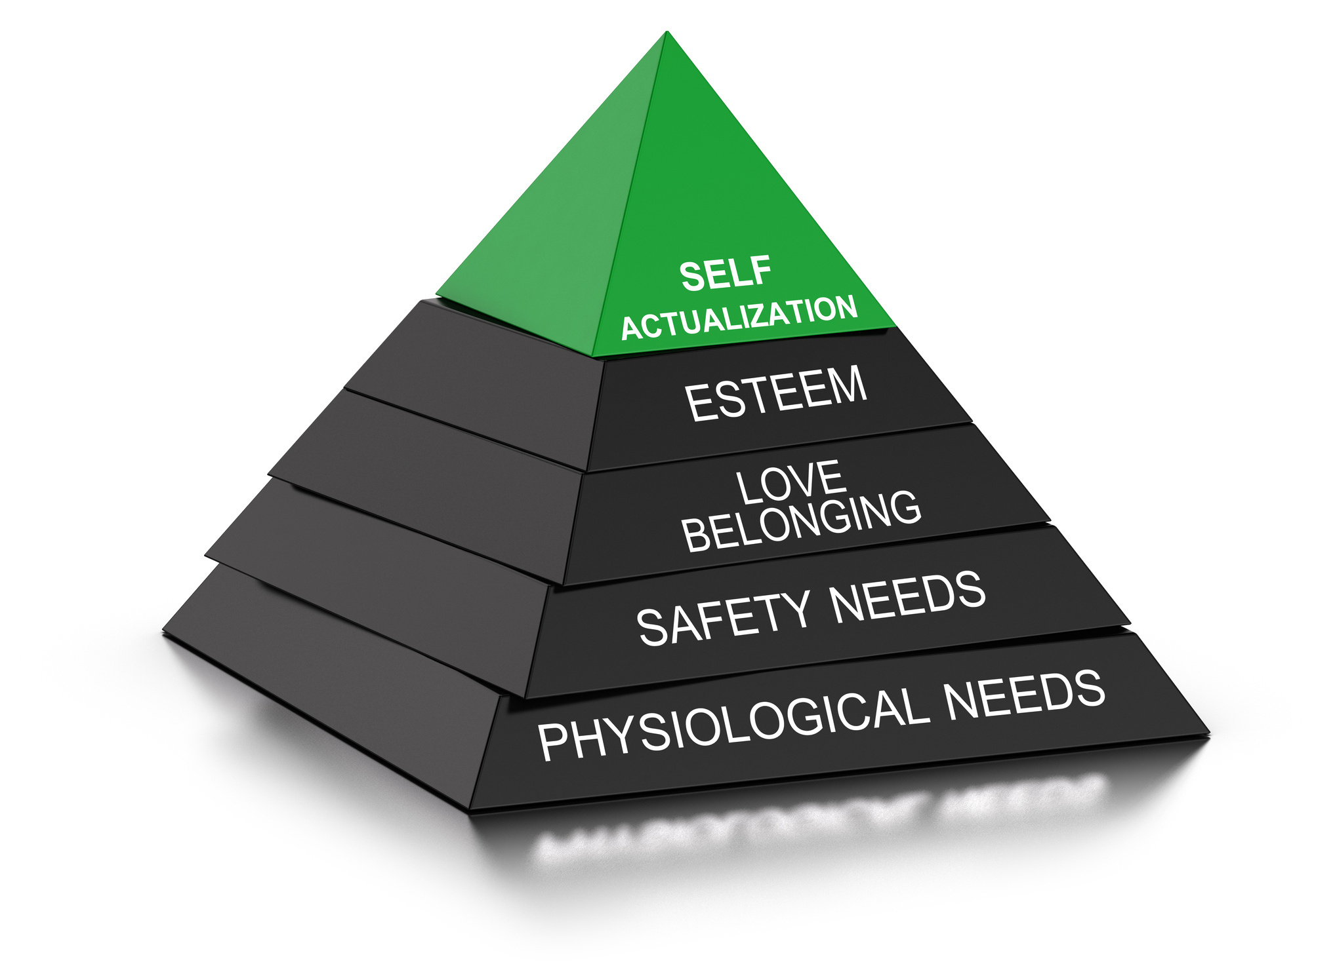
Thank You!
“Thank you for being such an attentive audience. Your time and interest are truly appreciated.”

